Slide 1
PREVALENCE OF DEPRESSION AND BURNOUT

Slide 2
PREVALENCE OF DEPRESSION AND BURNOUT
IN OLD AGE HOME INDIVIDUALS: A CROSS SECTIONAL STUDY

Slide 3
Introduction
Aging is a natural process that comes with various physical, social, and psychological changes. Throughout the 20th century, the number of older individuals in both developed and developing countries has significantly risen.
The global population is undergoing a notable shift towards aging. This trend is also apparent in correctional facilities around the world. Human life comprises five distinct stages: infancy, childhood, adolescence, adulthood, and old age, each presenting its own unique challenges. Old age, in particular, is a universal experience marked by physical decline, social isolation, and a range of health issues.
Geriatrics is concerned with the medical care of older adults, whereas gerontology examines the physical and psychological changes that come with aging. India is experiencing a demographic shift, marked by a growing elderly population (aged 60 and above) as a result of lower mortality rates, decreased fertility, and increased life expectancy.

Slide 4
Aging
A gradual diminution in physiological capacity of various systems like musculoskeletal, cardiovascular, neuropsychiatry and immune.
An increase in prevalence of diseases like arthritis, hypertension, stroke, dementia, and infectious diseases.
A reduction in functional capacity.
Obesity, falls, social isolation and depression.

Slide 5
Aging (cont.)
Chronic disability.
Death.

Slide 6
Relationships Between Disease, Disability and Death
Schematic presentation of relationships between disease, disability and death (2).
Image: image_path_goes_here

Slide 7
THEORIES OF AGING
(2)

Slide 8
Understanding the Elderly
Definitions, Classifications, and Demographic Trends

Slide 9
Defining the Elderly
Conventionally, elderly refers to those 65+ years old. However, health issues can begin in the 40s/50s, while others stay active into their 70s.
Therefore, defining this demographic hinges on health status, marked by multiple health issues and unusual illness presentations like confusion, falls, and mobility/functional decline.
Healthcare focus shifts from primary prevention to secondary prevention and chronic disease management. Categorization into smaller age groups aids in addressing evolving patient care goals.

Slide 10
Classification of the Elderly
Breaking down the elderly population into more manageable age groups based on health status and life expectancy allows for tailored care and support.

Slide 11
Young-Old (65-75)
Individuals in this age range often have similarities with middle-aged individuals, usually experiencing little to no disability.
Considering their life expectancy is around 15 to 20 years, they are in a relatively stable phase of life.

Slide 12
Middle-Old (75-85)
During this stage of life, chronic health conditions frequently arise, and life expectancy tends to decrease, with fewer additional years anticipated.

Slide 13
Old-Old (85+)
This category consists of individuals who are older than 85 years.
Considering their limited life expectancy, which is around 5 to 6 more years.

Slide 14
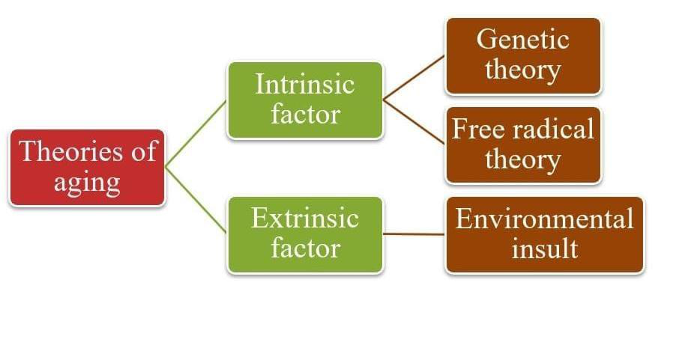
Age Group Breakdown
Visual representation of the distribution of elderly individuals across the three age groups, highlighting the increasing prevalence of health concerns with age.

Slide 15
Demographic Trends: Global and Indian
Countries face a significant increase in aging populations, creating strain on the working-age demographic.
India (2011 data):
Proportion of elderly population – 8.2%
Geriatric population growth rate – 1.9%
Old age dependency ratio – 14.2
Physically disabled elderly – 5177 per 1 lakh.

Slide 16
Factors Driving Demographic Changes
Progress in medical science
Adoption of healthier habits
Greater access to healthcare services
Significant decrease in perinatal and infant mortality rates
Continuous drop in death rate from infectious diseases
Improved health prior to age 65
Enhanced sanitation and nutrition standards
Strengthened economy

Slide 17
Factors Driving Demographic Changes (cont.)
Increased engagement in own health
Readily available information
Societal emphasis on youthfulness
Desire to take an active role
Aspiration to promote health
Curiosity about innovative approaches

Slide 18
HEALTHY AGING
Key factors for healthy aging.

Slide 19
DEPRESSION
It is a mood disorder resulting from persistent feelings of sadness, hopelessness, and lack of interest or pleasure in previously enjoyed activities.
It affects how a person thinks, feels, and behaves; it can lead to a variety of emotional and physical problems.
The functions of daily life such as work, relationships, and other aspects of life experience an interference.

Slide 20
Symptoms of Depression
Common symptoms include persistent sadness or low mood, irritability, the loss of interest in activities, fatigue, a change in appetite or sleep, feelings of worthlessness or guilt and difficulty concentrating leading to thoughts of death or suicide.

Slide 21
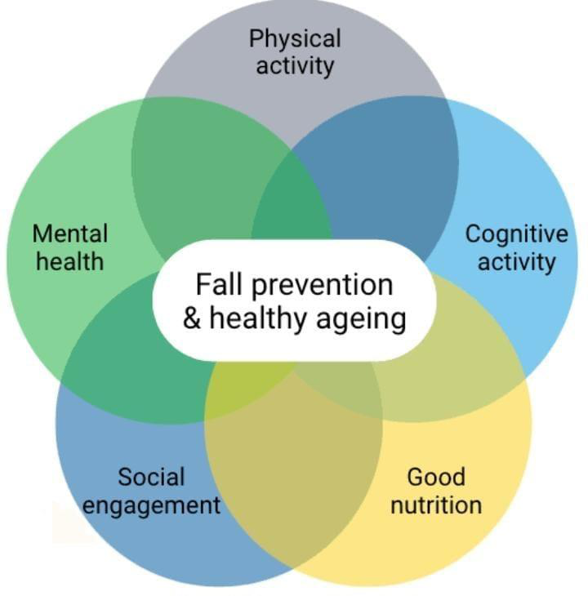
Symptoms of Depression
Illustration of common depression symptoms.

Slide 22
BURNOUT
Persistent stress, especially in work environments, results in a number of emotional, physical, and psychological exhaustion known as 'burnout.'
It primarily manifests as feelings of energy depletion or exhaustion, an increased mental distance from one's job, and a sense of ineffectiveness or lack of accomplishment.
Burnout can lead to lower performance and has negative effects on the person's well-being.

Slide 23
Symptoms of Burnout
The three main symptoms of burnout are emotional exhaustion, depersonalization, and reduced personal accomplishment.
This can cause feelings of frustration, cynicism, and lack of motivation, leaving many affected individuals unable to cope with stress.

Slide 24
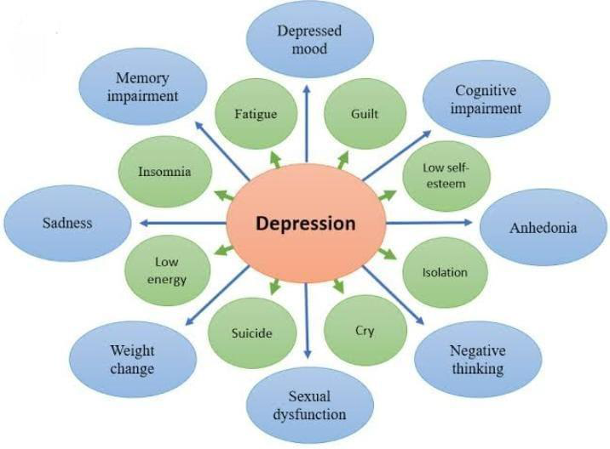
Symptoms of Burnout
Visual representation of Burnout Symptoms.

Slide 25
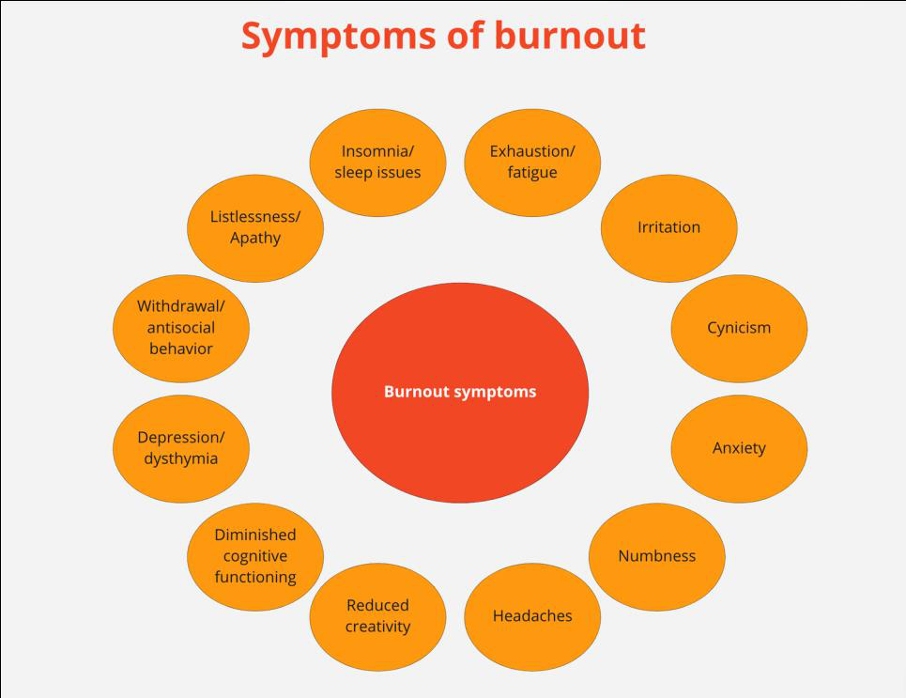
Symptoms of Burnout
Graphical symptoms of Burnout.

Slide 26
NEED OF STUDY

Slide 27
NEED OF STUDY
There is a need to investigate the prevalence of depression and burnout among individuals residing in old age home, as this vulnerable population may be at increased risk due to factors such as social isolation, loss of loved ones, elder abuse and declining health. This study will help to understand the magnitude of this issue (i.e: depression and burnout) and encourage the health care professionals for development of targeted interventions and improve the mental health and well-being of this population.

Slide 28
AIMS AND OBJECTIVES

Slide 29
Aims and Objectives

Slide 30
Aims
To study the prevalence of depression and burnout among individuals residing in old age home.

Slide 31
Objectives
1. To evaluate prevalence of depression among old age home individuals using geriatric depression scale.
2. To evaluate prevalence of burnout among old age home individuals using maslach burnout inventory.

Slide 32
Hypothesis

Slide 33
Hypothesis
NULL HYPOTHESIS (H0):
There is a no significant prevalence of depression among individuals residing in old age homes. (H₀ a)
There is a no significant prevalence of burnout among individuals residing in old age homes. (H₀ b)
ALTERNATIVE HYPOTHESIS (H1):
There is a significant prevalence of depression among individuals residing in old age homes.( H1 a)
There is a significant prevalence of burnout among individuals residing in old age homes.( H1 b)

Slide 34
Review of Articles
A summary of key findings from recent studies on depression and burnout among healthcare professionals.

Slide 35
Depression Prevalence Among Elderly in India (Pilania et al, 2019)
Pilania et al. (2019) reviewed 51 studies from 16 Indian states, estimating depression prevalence among the elderly at 34.4% (95% CI: 29.3–39.7).
Prevalence was higher among females, rural populations, and in eastern India. Non-probability sampling and specific screening tools (GDS, CES-D) showed higher prevalence. Excluding smaller or low-quality studies did not change the estimate.
Exclusion of dementia cases prior to assessment resulted in lower depression prevalence. The authors concluded that about one-third of the Indian elderly population suffers from depression, particularly women.
The estimates varied based on study tools, geography, sampling, and dementia presence. Caution is advised when interpreting the pooled estimate due to methodological variations and screening tool differences across the included studies.

Slide 36
Burnout in Medical/Surgical Residents (Low et al, 2019)
Low et al. (2019) conducted a meta-analysis and found the aggregate burnout prevalence at 51.0% in 22,778 residents. Meta-regression showed that mean age (β = 0.34, 95% CI: 0.28–0.40, p < 0.001) and the proportion of males (β = 0.4, 95% CI = 0.10–0.69, p = 0.009) were significant moderators.
Radiology (77.16%), neurology (71.93%), and general surgery (58.39%) had the highest burnout prevalence. Psychiatry (42.05%), oncology (38.36%), and family medicine (35.97%) had the lowest.
Burnout prevalence in Asian countries was 57.18%, in European countries 27.72%, and in North America 51.64%. The authors concluded that burnout is highly prevalent among medical/surgical residents. Older and male residents were more affected.

Slide 37
Global Burnout Among Nurses (Woo et al, 2020)
Woo et al. (2020) analyzed 113 studies and conducted a meta-analysis of 61 studies, encompassing 45,539 nurses across 49 countries. The overall pooled-prevalence of burnout symptoms among global nurses was 11.23%.
Significant differences were noted between geographical regions, specialties, and burnout measurement methods. Sub-Saharan Africa showed the highest burnout prevalence, while Europe and Central Asia had the lowest. Pediatric nurses had the highest prevalence among specialties, while geriatric care nurses had the lowest.
This study is the first to synthesize published studies and estimate pooled-prevalence of burnout symptoms among nurses globally. The authors concluded that high burnout prevalence warrants attention and implementation of interventions to improve nurses’ work conditions and healthcare quality.

Slide 38
Burnout Among Intensive Care Physicians (Sanfilippo et al, 2020)
Sanfilippo et al. (2020) reviewed 31 studies describing burnout in ICU staff. Five focused solely on physicians, and 12 others provided separate physician data. Burnout prevalence varied greatly (18% - 49%), but methodological discrepancies (cut-off criteria, Likert scale variability) precluded pooled analysis.
The authors concluded that burnout syndrome prevalence among ICU physicians is relatively high, but methodological heterogeneities necessitate cautious interpretation.
The need for a consensus recommending consistent use of the Maslach Burnout Inventory test is urgent to accurately screen burnout in ICU physicians.

Slide 39
Prevalence & Incidence: Depression & Burnout Studies

Slide 40
Depression Prevalence Over Time: Meta-Analysis
19 studies examined changes in depression prevalence over time.
Meta-analysis of 17 studies showed a significant increasing trend:
* Pooled Odds Ratio (OR): 1.35 (95% CI: 1.14, 1.61)
* Similar effects observed for both females and males.
* High heterogeneity across studies remained unexplained.
* No evidence of publication bias was found.
Conclusion: Depression is increasingly prevalent, and study design differences or publication bias do not fully account for this trend.

Slide 41
Depression in Older Adults: Systematic Review & Meta-Analysis
Yosef Zenebe et al. (2021) reviewed depression prevalence in older adults.
* Analyzed 42 studies with 57,486 elderly participants.
* Average expected prevalence: 31.74% (95% CI 27.90, 35.59).
Subgroup analysis revealed:
* Higher prevalence in developing countries (40.78%) vs. developed countries (17.05%).
* Higher prevalence with Geriatric Depression Scale-30 (GDS-30) (40.60%) compared to GMS (18.85%).
* Higher prevalence in studies with smaller sample sizes (40.12%) than larger sample sizes (20.19%).

Slide 42
Depression in Older Adults: Systematic Review & Meta-Analysis (cont.)
Conclusion: High depression prevalence in older adults warrants proactive measures by healthcare professionals and policymakers.

Slide 43
Burnout Syndrome During COVID-19: Radiologists Study
A. Oprisan et al. (2022) examined burnout in radiologists during COVID-19.
* Burnout significantly increased during the pandemic (49.3% vs. 33.6%, p = 0.002).
* No correlations found between burnout and gender, age, call frequency, experience, income, teaching, marital status, number of children, or contract type.
* No risk or protective factors valid both before and after the pandemic were identified.
* No correlations were identified between sociodemographic or work-related characteristics and burnout syndrome.
Conclusion: The study emphasizes the need for support for the professional wellbeing of radiologists in Spain.

Slide 44
Burnout Prevalence in Switzerland: Point Prevalence Study
Y. Shoman et al. (2022) assessed burnout prevalence in Switzerland.
* Identified 23 studies on workers in Switzerland.
* Clinical or severe burnout prevalence: 4% (95% CI 2–6%).
* Average prevalence:
* Overall burnout: 18% (95% CI 12–25%)
* Emotional exhaustion: 18% (95% CI 15–22%)
* Clinical/severe burnout was higher among healthcare workers compared to the general working population.
* Estimates of pre-pandemic burnout are comparable to other countries where burnout is recognized as a disease.

Slide 45
Burnout Prevalence in Switzerland: Point Prevalence Study (cont.)
Conclusion: The results may prove useful in planning and assessing the effectiveness of interventions for prevention of occupational burnout and in minimising its negative consequences on individuals and on societies during and after the pandemic.

Slide 46
Burnout Prevalence Among Psychiatrists: Meta-Analysis
K.V. Bykov et al. (2022) conducted a meta-analysis on burnout in psychiatrists.
* Included 36 studies with 5481 participants.
* Prevalence of overall burnout:
* 25.9% (MBI)
* 50.3% (CBI)
* Pooled prevalence for MBI subscales:
* High emotional exhaustion (EE): 43.5%
* High depersonalization (DP): 28.2%

Slide 47
Burnout Prevalence Among Psychiatrists: Meta-Analysis (cont.)
* Low personal accomplishment (PA): 32.4%
* European psychiatrists showed lower EE scores compared to non-European psychiatrists.
Conclusion: Burnout is highly prevalent among psychiatrists. Future research needed on screening, predictors, and effective interventions.

Slide 48
Burnout Among Nursing Students: Systematic Review
L.N. Kong et al. (2023) examined burnout in nursing students.
* 21 studies included, involving 10,861 students.
* Pooled prevalence of burnout: 23.0% (95% CI = 15.6–30.5%).
* Pooled prevalence of subscales:
* Emotional exhaustion: 47.1%
* Depersonalization: 32.2%
* Reduced personal accomplishment: 43.5%
* Associated factors included: demographic, educational, physical, and psychological.

Slide 49
Burnout Among Nursing Students: Systematic Review (cont.)
Conclusion: Burnout is common in nursing students. Early screening and interventions are crucial for prevention and reduction.

Slide 50
Depression & Drug Use in Elderly in Kathmandu
R.K. Rokaya et al. (2023) studied depression and drug use in elderly living in old age homes in Kathmandu.
* Out of 150 respondents, 25 were normal, 98 had mild and 27 had severe depression.
* Age distribution: 7.33% (60-64yrs), 10.66% (65-69 yrs), 31.33% (70-79 yrs), 51.33 (> 80 yrs).
* 100% regularly used drugs, averaging >21 drug classes.
* Common drug classes: antihypertensives, vitamins, cardiac drugs, cardiovascular dilators, laxatives, tranquilizers, diuretics.
* Less common: sedatives, hypnotics, antidepressants, anti-arrhythmic drugs, pulmonary drugs, antacids, antisecretory agents.

Slide 51
Burnout in Healthcare Workers: A Global Perspective
V.V. Botiakova (2023) studied burnout in healthcare workers in North and South America, and Asia (2018-2022).
* Burnout prevalence ranged from 1.3% to 82.1%.
* Prevalence in North and South America varied from 1.3% to 73.5%.

Slide 52
Burnout and Depression Prevalence Studies
A Review of Recent Research Findings

Slide 53
Overview of Burnout Prevalence
Studies show burnout prevalence varies across regions and professions.
In Asia, rates ranged from 1.3% to 82.1%.
North and South America had rates between 1.3% and 73.5%. Asia showed higher variability.
High-risk groups include intensivists, oncologists, and emergency medicine physicians.
Research highlights the need for interventions to address burnout.

Slide 54
Study on Older Adults in Rural Odisha (2023)
Annu Antony et al. (2023) studied burnout in rural Odisha.
The sample included 520 older adults, with 497 eligible.
The non-response rate was 3.6%, achieving 96.4% coverage (479).
Gender distribution was nearly equal (55.8% women, 44.2% men).
73% were in the 60-74 age group, and 7% were > 85 years.
59.5% resided in joint families, and 66.2% lived with spouses.
Most were illiterate (41.9%), unemployed (52.4%), and had low socioeconomic status (53.2%).
48.5% had medical conditions.

Slide 55
Burnout Among Medical and Surgical Residents
A study found burnout prevalence of 51.64% (46.96–56.28) in North America.
Findings suggest high burnout among medical and surgical residents.
Older and male residents experienced more burnout than their counterparts.

Slide 56
Global Burnout Symptoms Among Nurses (2020)
T Woo et al. (2020) studied global burnout in nurses.
Burnout is now recognized as an “occupational phenomenon” (ICD-11).
Nurses struggle with burnout, impacting patients, colleagues, and organizations.
Meta-analysis examined burnout prevalence in nurses worldwide.
113 studies reviewed, 61 included in meta-analysis (45,539 nurses, 49 countries).
Overall pooled-prevalence was 11.23%.
Significant differences existed between regions, specialties, and measurements.
Sub-Saharan Africa had highest, Europe and Central Asia had lowest burnout.

Slide 57
Global Burnout Symptoms Among Nurses (2020) (cont.)
Pediatric nurses had highest, geriatric care nurses had lowest burnout.
The study suggests nurses have high burnout, warranting attention and action.

Slide 58
Burnout Among Intensive Care Physicians (2020)
Filippo Sanfilippo et al. (2020) studied burnout in ICU physicians.
31 studies were included with various healthcare profiles.
5 focused solely on physicians, 12 included physicians with separate data.
Burnout prevalence varied (18% - 49%), but methodological discrepancies made pooled analysis difficult.
Cut-off criteria for defining burnout and Likert scale variability were factors.

Slide 59
Burnout Syndrome in ICU Physicians
Burnout prevalence is relatively high among ICU physicians.
Methodological heterogeneities require caution when interpreting results.
Reported burnout levels seem higher than in studies investigating mixed ICU personnel.
There's an urgent need for consistent Maslach Burnout Inventory use to screen burnout and provide precise figures.

Slide 60
Global Trends in Depression (2021)
D Moreno-Agostino et al. (2021) studied global depression trends.
19 studies provided information on changes in depression prevalence.
Pooled odds ratio (OR) was 1.35 (95% CI: 1.14, 1.61).
Similar pooled effects were observed for females and males.
High heterogeneity across studies remained unexplained.
No evidence of publication bias was found.
There's an increasing trend in the likelihood of experiencing depression.

Slide 61
Depression Among Older Adults (2021)
Yosef Zenebe et al. (2021) studied depression in older adults.
Review of 1263 articles identified 42 relevant studies (n = 57,486).
Average expected prevalence of depression was 31.74% (95% CI 27.90, 35.59).
Sub-group analysis: developing countries (40.78%), developed countries (17.05%).
GDS-30: 40.60%, GMS: 18.85%. Smaller sample size: 40.12%, larger: 20.19%.
High depression prevalence among older adults worldwide.
Early warning and advised health professionals, policymakers to take action.

Slide 62
Burnout Syndrome During COVID-19 Pandemic (2022)
A oprisan et al. (2022) studied burnout during the COVID-19 pandemic.
Burnout significantly increased in radiologists, affecting nearly half of respondents.
These results highlight the need to assess support for radiologists' professional wellbeing.

Slide 63
Burnout Syndrome Research
Analysis of Prevalence and Methodologies

Slide 64
Burnout in Spain: A COVID-19 Impact
A study in Spain found no correlation between burnout and factors like gender, age, income, or marital status.
However, the prevalence of burnout significantly increased during the COVID-19 pandemic (49.3% vs. 33.6%, p = 0.002).
No consistent risk or protective factors were identified before and after the pandemic.
Sociodemographic and work-related characteristics also showed no correlation with burnout syndrome.

Slide 65
Burnout Prevalence in Switzerland (2022)
A 2022 study (Y shoman et.al) examined burnout prevalence in Switzerland.
Analysis of 23 studies indicated:
* Clinical or severe burnout: 4% (95% CI 2–6%)
* Overall burnout: 18% (95% CI 12–25%)
* Emotional exhaustion: 18% (95% CI 15–22%)

Slide 66
Burnout Prevalence in Switzerland (2022) (cont.)
Healthcare workers showed higher rates of severe burnout compared to the general working population.
These findings are comparable to pre-pandemic levels in countries where burnout is recognized as a disease.

Slide 67
Burnout Among Psychiatrists (2022)
A meta-analysis (KV Bykov et.al, 2022) investigated burnout prevalence among psychiatrists.
Thirty-six studies (5481 participants) were included. Results:
* Overall burnout (MBI): 25.9% [11.1%–40.7%]
* Overall burnout (CBI): 50.3% [30.9%–69.8%]
* High emotional exhaustion: 43.5% [27.9%–59%]
* High depersonalization: 28.2% [17.5%–38.9%]

Slide 68
Burnout Among Psychiatrists (2022) (cont.)
* Low personal accomplishment: 32.4% [3.4%–61.3%]
European psychiatrists reported lower emotional exhaustion scores than non-European colleagues.
The study concluded that burnout is highly prevalent among psychiatrists, calling for further research on screening, predictors, and intervention strategies.

Slide 69
Methodology Overview
A look at the study design, sample, data sources, duration, and sampling approach for this research project.

Slide 70
Study Design and Sample Size
1. Study design: A cross-sectional study
2. Sample size: n = 120
Formula: 𝑛 = \frac{𝑍2 ⋅𝜎2}{𝐸2}

Slide 71
Data Sources and Study Duration
3. Source of data: The study will be conducted in the following places:
* Sandhya Old age home , Irana
* Anand Old age home , nanikadi
* Old age home , Kalyanpura
* Swarg Old age home
* Shiv Home Care
* Krishna Old age home

Slide 72
Data Sources and Study Duration (cont.)
4. Study duration: 6 months

Slide 73
Sampling Technique
5. Sampling technique: Consecutive sampling technique

Slide 74
Inclusion and Exclusion Criteria
Inclusion criteria:
* Age: adults aged ≥ 65 years
* Subjects diagnosed with hypertension and diabetes mellitus
* Both male and female
* Willingness to participate

Slide 75
Exclusion Criteria

Slide 76
Exclusion Criteria Details
Subjects with cognitive impairment
Subjects with cardiopulmonary, musculoskeletal, or neurological disorders (e.g., Parkinson’s, stroke, multiple sclerosis, head injury) that may affect functional mobility.
Subjects on anti-depressant / tranquilizer drugs within the last year.
Subjects with visual or hearing problems.
Subject diagnosed with severe psychological disorder within the last year.
Recent injury or surgery: individuals who have undergone recent major surgery or experienced a significant injury that may affect their ability to participate within the last year.
Subject going on any Psychological counselling session.
Subjects with a history of substance abuse

Slide 77
Materials and Apparatus
Pen / Pencil
Paper
Writing pad
Calculator
Chair
Table
Subject information sheet
Assessment form

Slide 78
Materials and Apparatus (cont.)
Consent form (Gujarati and English)

Slide 79
Scales Used

Slide 80
Scales
Geriatric Depression Scale (GDS)
Maslach Burnout Inventory (MBI)

Slide 81

Tools
Photograph No: 1 showing the tools used in the study.

Slide 82
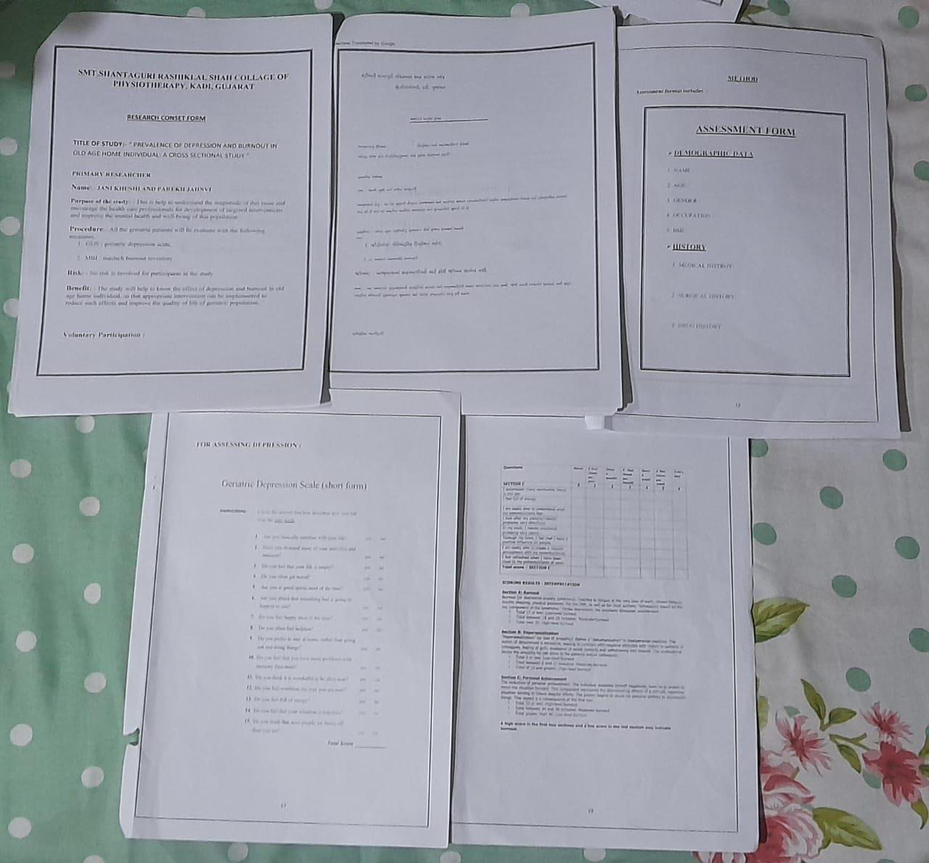
Consent Forms
Photograph No: 2 displaying consent forms and data collection sheets.

Slide 83
Outcome Measures

Slide 84
Geriatric Depression Scale (GDS)
Reliability: 0.80 to 0.90
Validity: 80% to 90%

Slide 85
Maslach Burnout Inventory (MBI)
Reliability: 0.70 to 0.90
Validity: 0.70 to 0.90

Slide 86
Methods for Assessment
Depression and Burnout Screening Tools

Slide 87
Assessing Depression
Using the Geriatric Depression Scale (GDS)

Slide 88
Geriatric Depression Scale (GDS)
The GDS is a screening tool for identifying depression in elderly adults. It has been extensively tested and used with older populations.
A short form GDS consists of 15 questions with yes/no answers related to the past week. Questions were selected based on their high correlation with depressive symptoms.
Scoring:
* 0-4: Normal
* 5-8: Mild Depression
* 9-11: Moderate Depression

Slide 89
Geriatric Depression Scale (GDS) (cont.)
* 12-15: Severe Depression
The short form is suitable for physically ill or mildly demented patients with short attention spans. It takes about 5-7 minutes to complete.

Slide 90
Assessing Burnout
Using the Maslach Burnout Inventory (MBI)

Slide 91
Maslach Burnout Inventory (MBI)
The MBI is a screening tool used to identify symptoms of burnout in elderly adults. The MBI has been tested and used extensively with the older population.
The MBI consists of 22 items divided into 3 sub-scales:
1. Emotional Exhaustion (EE): 9 items, assessing feelings of depletion, exhaustion, and fatigue.
2. Depersonalization (DP): 5 items, assessing feelings of detachment, cynicism, and reduced empathy.
3. Personal Accomplishment (PA): 8 items, assessing feelings of competence, effectiveness, and accomplishment.

Slide 92
Maslach Burnout Inventory (MBI) (cont.)
Scores are calculated for each subscale by summing the ratings for each item. Higher scores indicate higher levels of burnout.
Burnout Levels:
* Low: Scores below the 25th percentile.
* Moderate: Scores between the 25th and 75th percentiles.
* High: Scores above the 75th percentile.

Slide 93
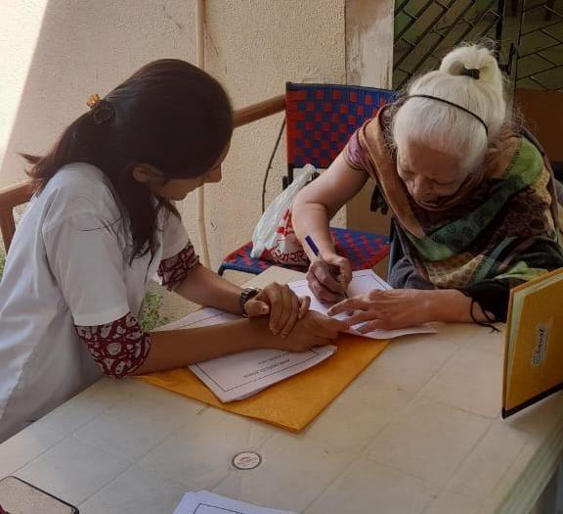
MBI Chart Visualization
Visualization of the MBI scores and burnout levels.

Slide 94
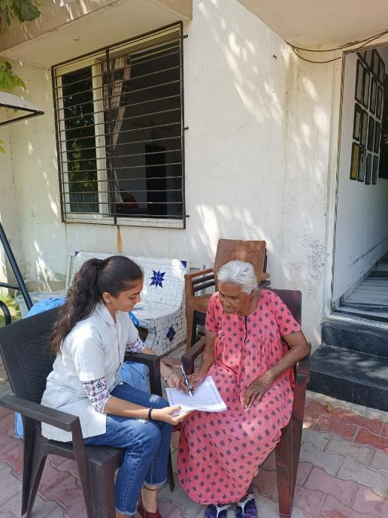
Depression and Burnout comparison
Visualization of the GDS and MBI Scores.

